Slide 1
Tom’s Cave Escape
CMPT 106 Group ζήτα | Poster Presentation

Slide 3
Overview of the Presentation
Objectives
Tasks and Accomplishments
Roles and Responsibilities
Highlights and Milestones
Problems and Downfalls
Improvements Needed
General Attributes
Applications and Prospects

Slide 4
Project Essentials
Objectives
Tasks and Accomplishments
Roles and Responsibilities

Slide 5
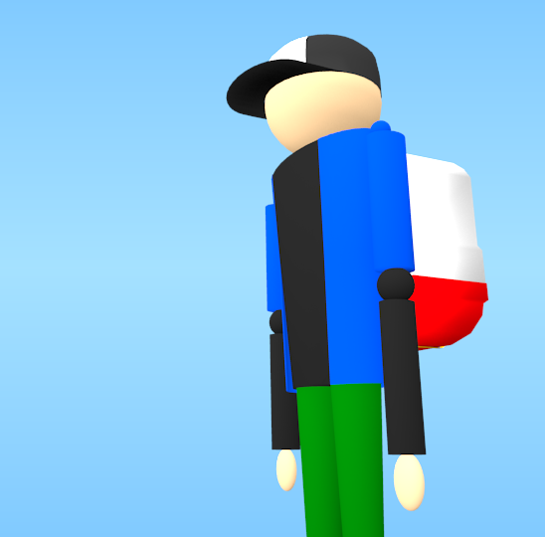
Objectives
a three-dimensional, multi-level, single-player, platformer game
intended for the general public, particularly those with personal computers

Slide 6
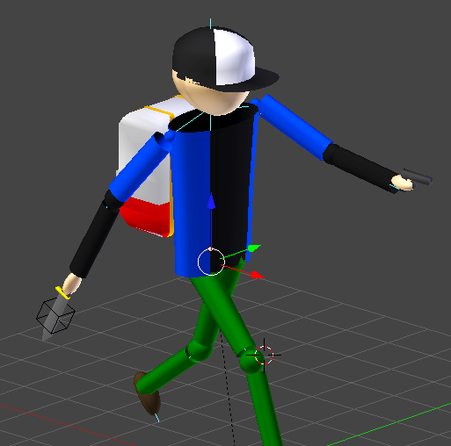
Objectives
Goal of the Project
Each member contributed in making the game
complete with challenges for the player to overcome,
with increasing difficulty for every consecutive level, and
with a gaming environment suited for the audience.

Slide 7
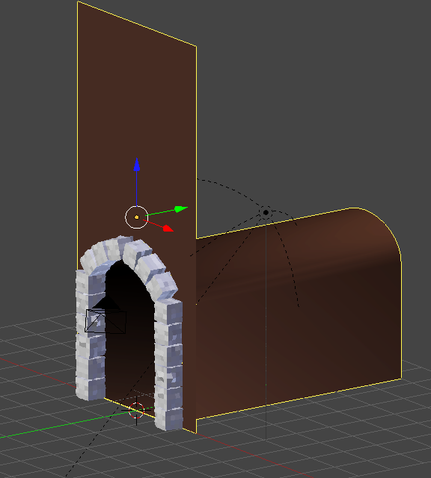
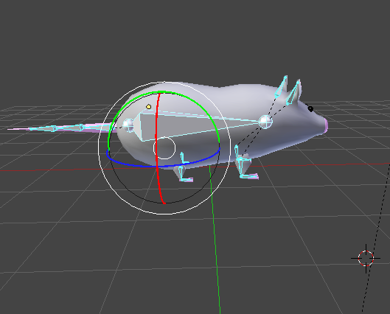
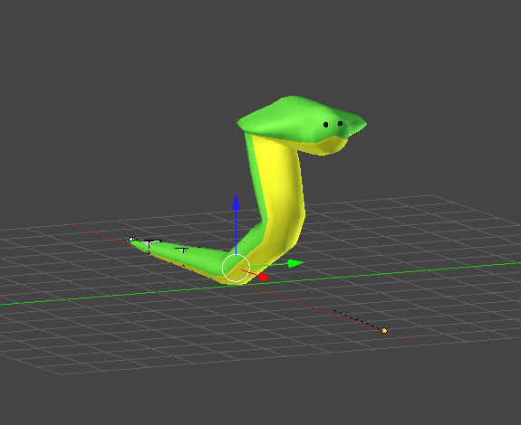
Tasks and Accomplishments
Modelling and Animation Team
Learned the basic tools and keyboard shortcuts of Blender
Modelled the main character, enemies, weapons, cave assets, and game environment
Implemented character animations
Designed props and costumes

Slide 8
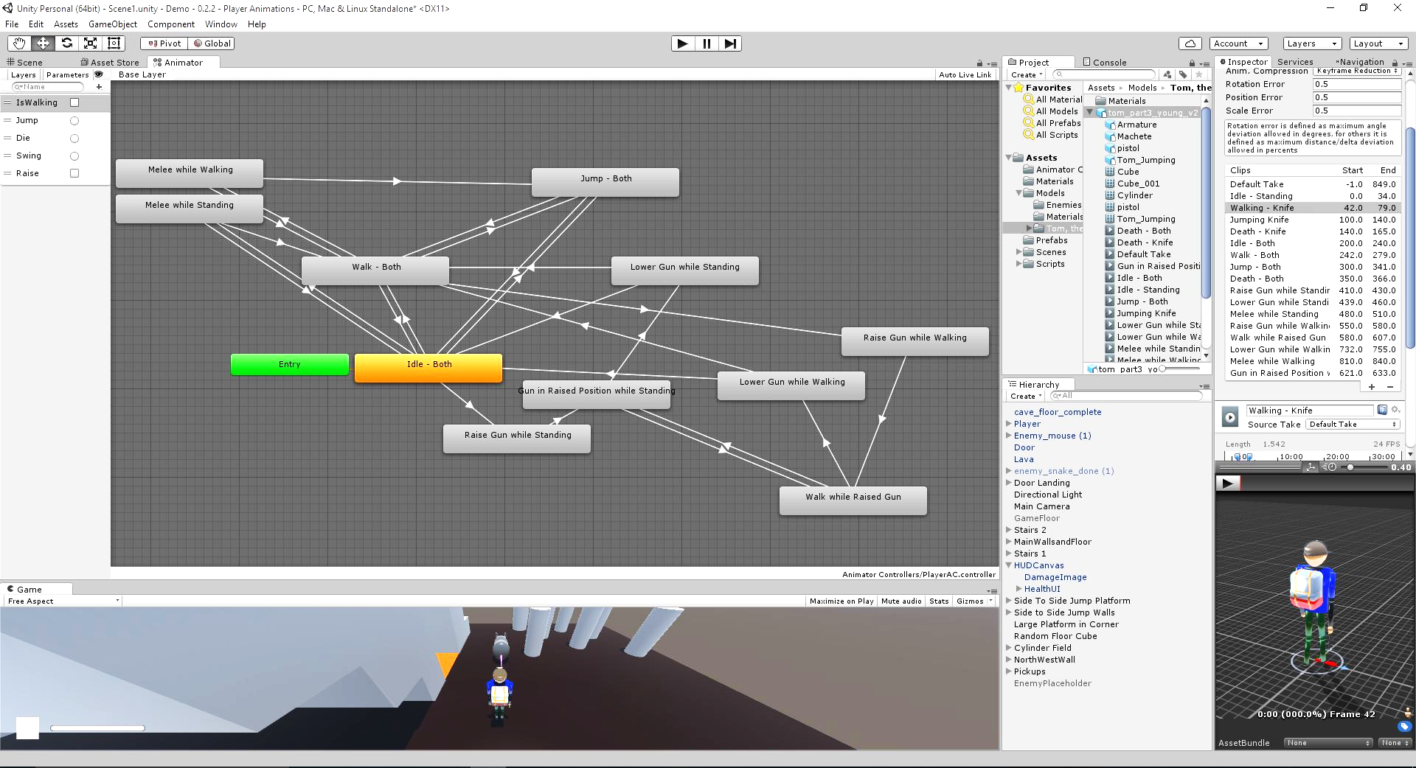
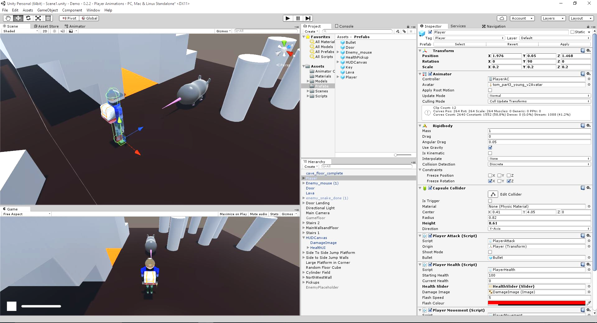
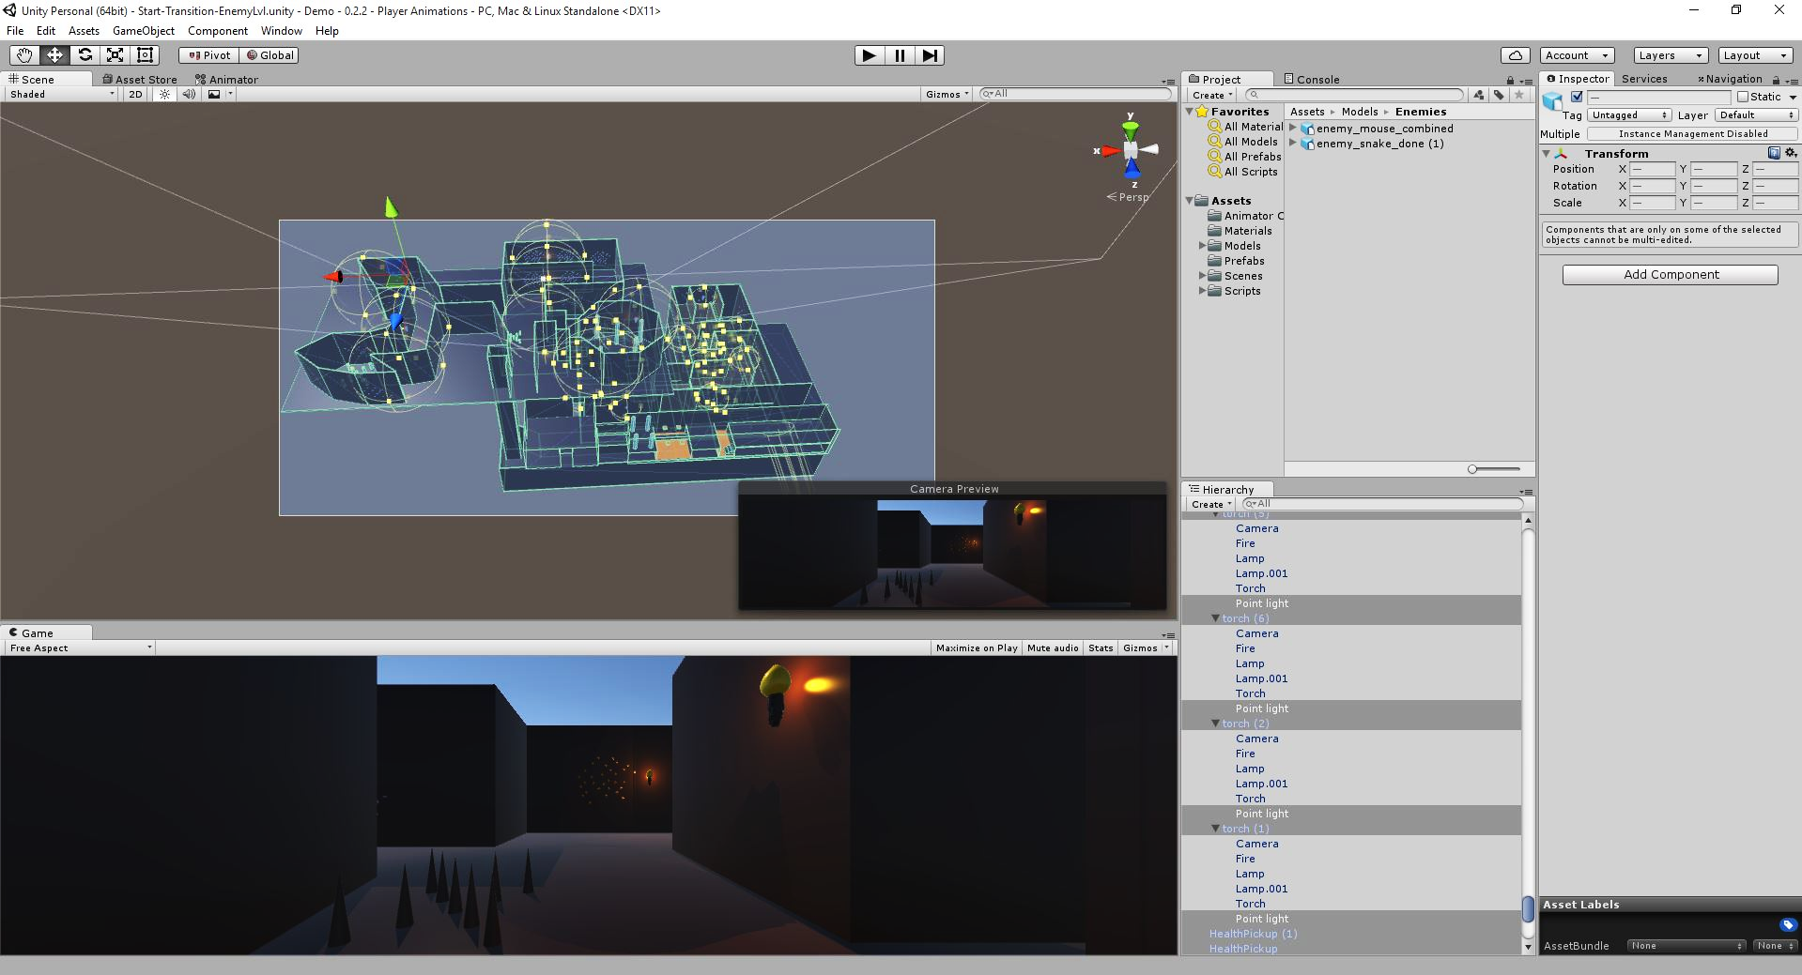
Tasks and Accomplishments
Coding, Scripting, and Game Design Team
Learned the basic tools and keyboard shortcuts of Unity
Wrote game scripts using C#
Analyzed and established game mechanics
Finalized game design and game interaction
Added lighting and sound effects to the game

Slide 9
Tasks and Accomplishments
Sounds and Special Effects Team
Added background music and sound effects to the game
Created the project proposal and poster presentation

Slide 10
The Road to Success
Highlights and Milestones
Problems and Downfalls
Improvements Needed

Slide 11
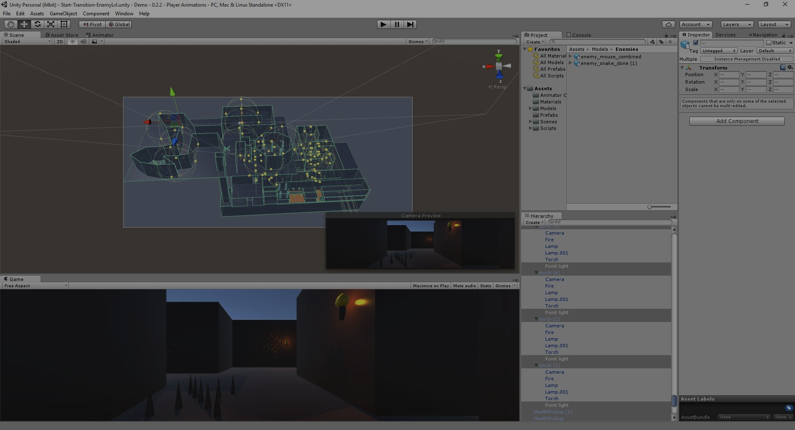
Successes and Highlights
This project accomplished all necessary tasks described in the Project Proposal!

Slide 12
Successes and Highlights
The main character and three types of enemies with the given abilities to walk, jump, and travel across platforms
The player can collect objects and weapons.
The camera locks on the player’s third person point-of-view.
The user interface - a scoreboard, health bar, etc.
Visually interesting environments that contribute to the story and the atmosphere of a mysterious cave
Background music and sound effects

Slide 13
Project Timeline and Direction
Achieving the first milestone
Creating a demo game for the Project Proposal (Weeks 2 to 6)
Modelling Team
modelled Tom and two weapons
implemented the basic character animations (walking, standing, and jumping)
Scripting Team
fixed the camera to the player
coded how the player can interact with pick-up objects and lava
added the game User Interface
Sounds and Special Effects Team
created the project proposal and PowerPoint presentations

Slide 14
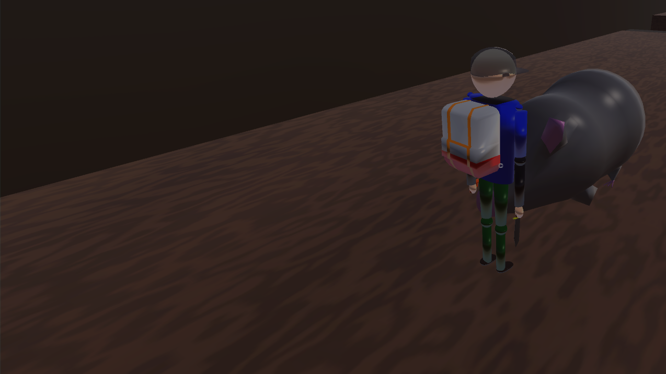
Project Timeline and Direction
Achieving the second milestone
Building a solid, basic level (Weeks 7 to 11)
Modelling Team
modelled the rat and snake enemies; designed cave assets and objects
added a variety of character animations
Scripting Team
built the regular level using the cave assets
used the characters and their corresponding animations; added enemy AI
scripted player combat systems and game mechanics
Sounds and Special Effects Team
designed sound effects and background music in Garageband
planned the poster content and design with the modelling team

Slide 15
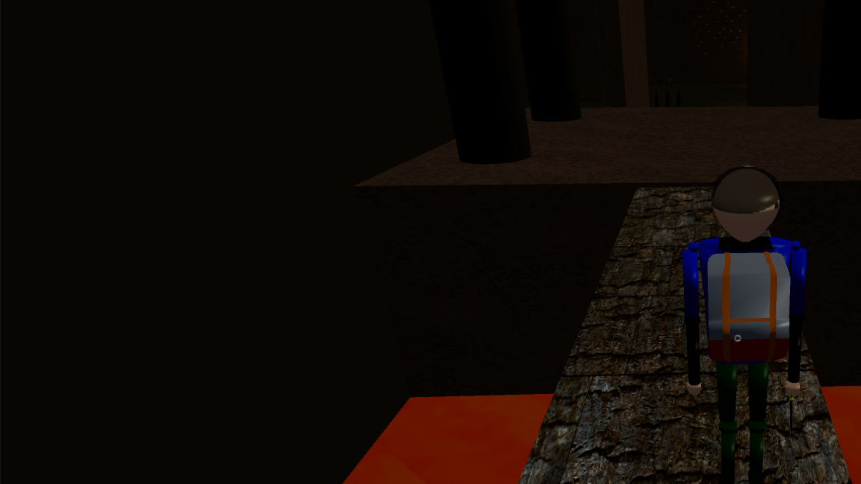
Project Timeline and Direction
Achieving the final milestone
Finishing a complete, sound, two-level 3D game (Weeks 12 to 13)
Modelling Team
provided textures for cave assets and environment
combined and finalized all character models and animations
Scripting Team
discussed about designing the regular and boss levels
created the second level and boss enemies
modified and scripted all characters to be completely functional
added audio and made final adjustments
Sounds and Special Effects Team
completed the poster and PowerPoint presentations

Slide 16
Problems and Downfalls
Weird body proportions and character animations
Camera did not lock or function properly
Problems with combining character animations
Blender files cannot properly import to Unity
Adding textures using UV images

Slide 17
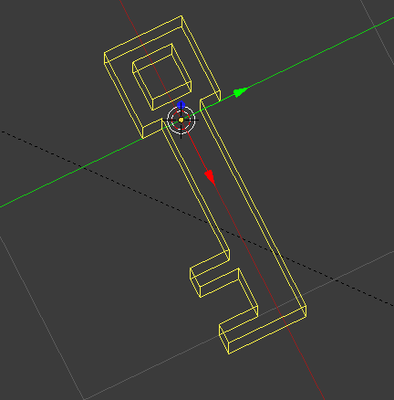
Improvements Needed
If we used all the time and encountered no issues:
More realistic and polished character models and cave assets
Smoother character animations; more variety of animations
More characters, weapons, and other assets
If we were given more time:
A beginning and ending scene
A start and pause menu; shortcut keys
More levels
A more detailed narration and storyline

Slide 18
Game Finished
General Attributes
Applications and Prospects

Slide 19
General Attributes
Applied many aspects of C/C++ and object-oriented programming
Experience in Blender and Unity
Critical thinking and analysis
Teamwork, collaboration, and communication
Careful planning and organization (e.g. dividing into teams, dividing tasks, level design, etc.)

Slide 20
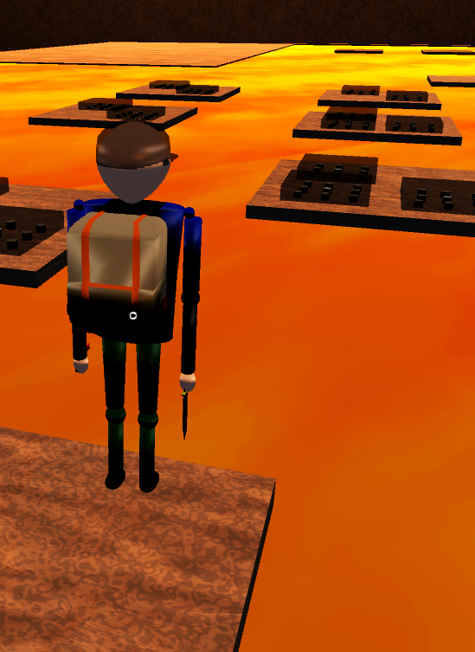
Applications and Prospects
Confident in building resumé and portfolio
Enhanced interest in game creation and design
Sense of a group atmosphere once we register for higher-level classes or enter the workforce

Slide 21
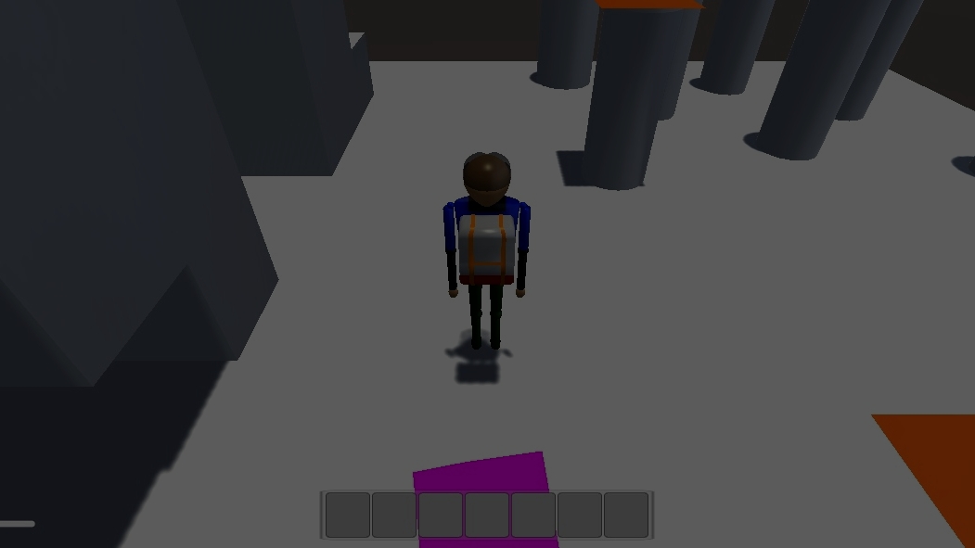
Acknowledgments
We would like to acknowledge our teaching assistant Mohmed Dalwai and our friends and family for supporting us all the way through.

Slide 22
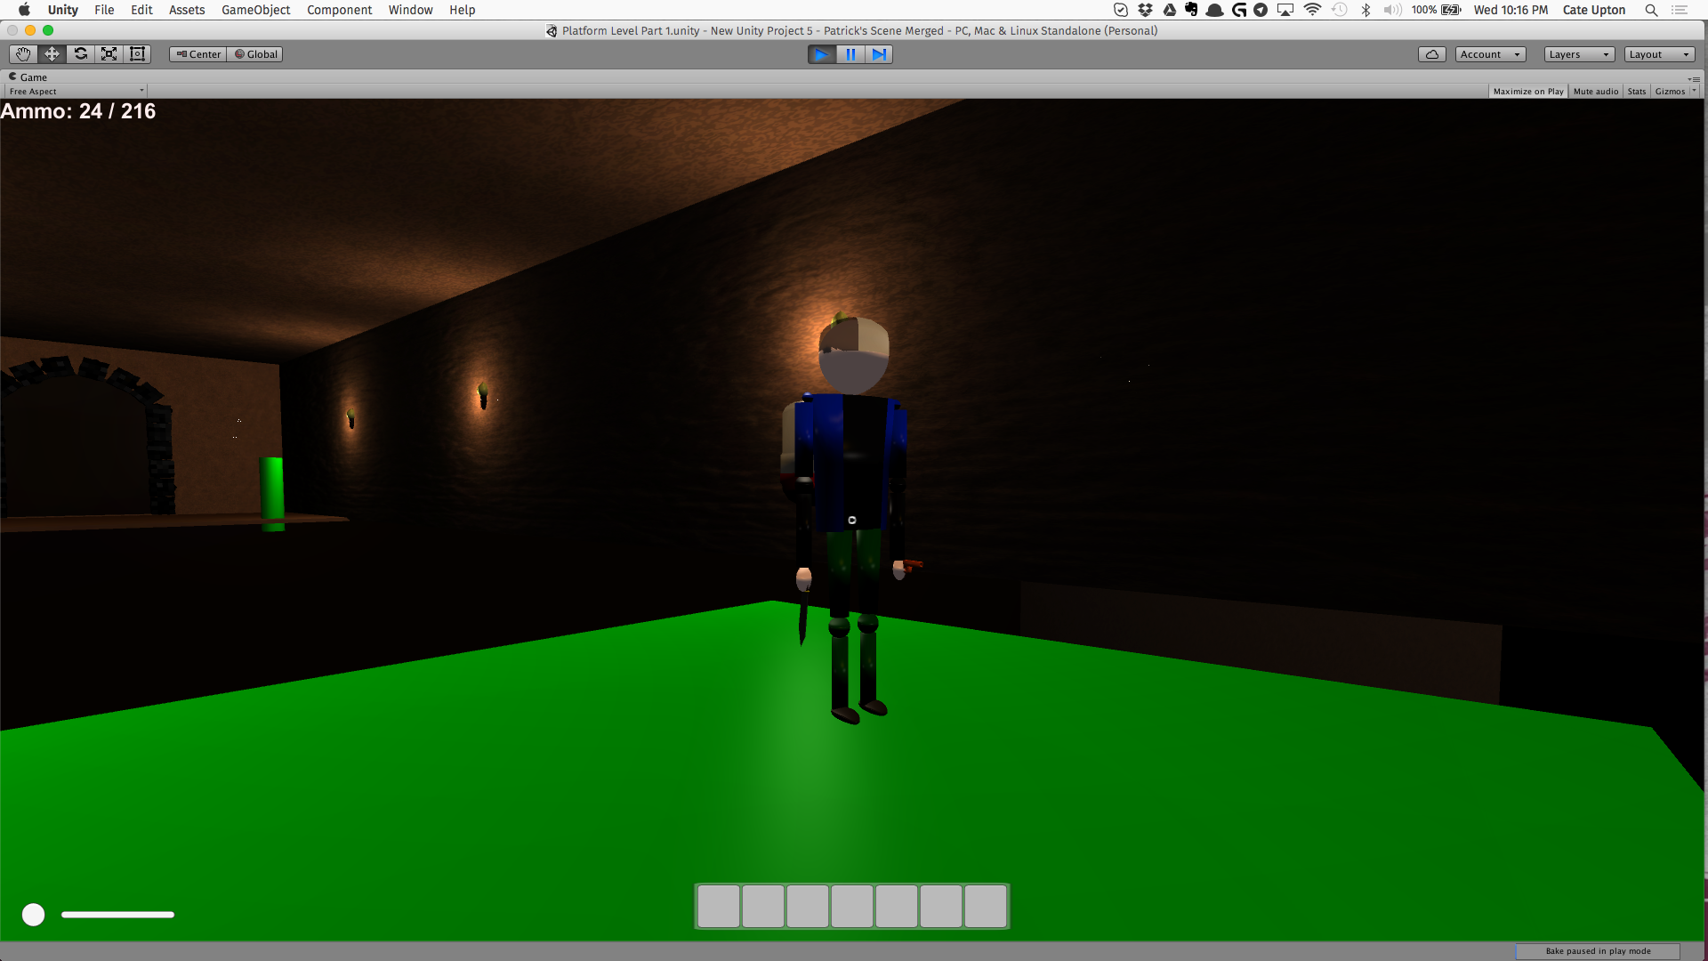
THANK YOU!
Tom’s Cave Escape | Group ζήτα

